Slide 1

Building user interfaces Thomas Künneth

Slide 2
Two types of UI elements
Interaction and display
Layout

Slide 3
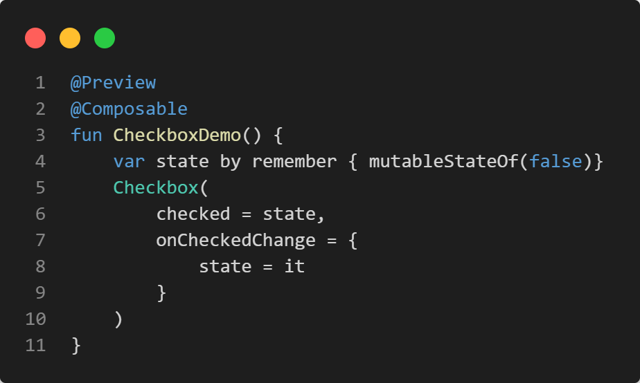
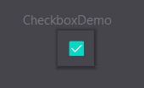

Slide 4
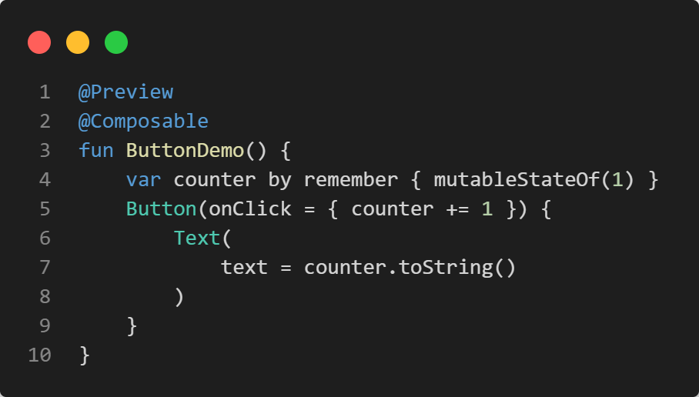
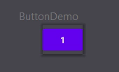

Slide 5
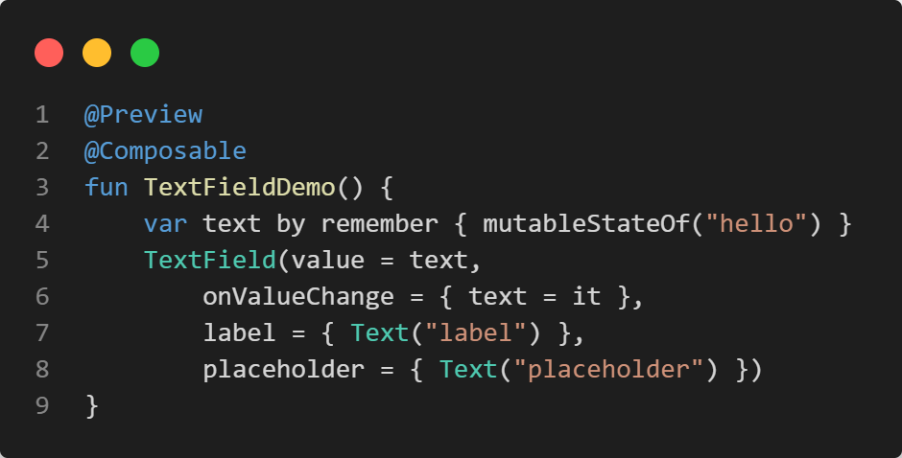
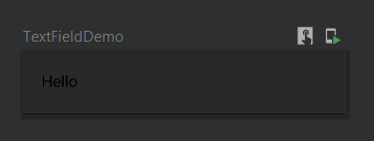

Slide 6
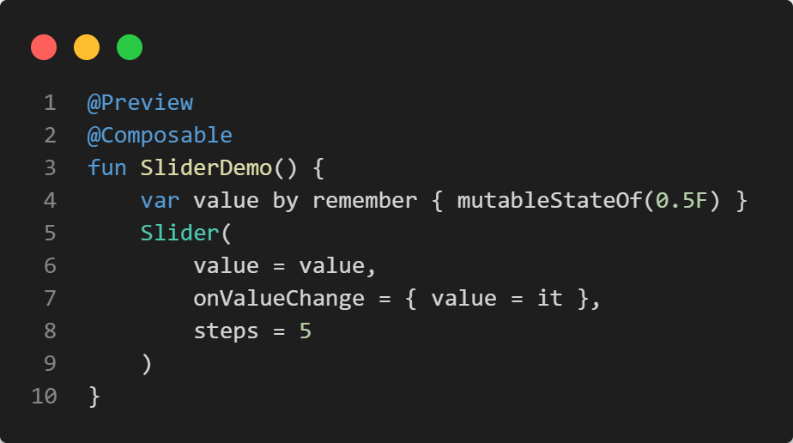
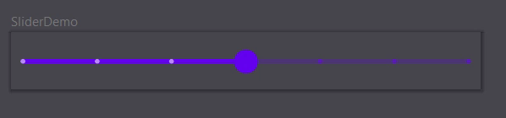

Slide 7
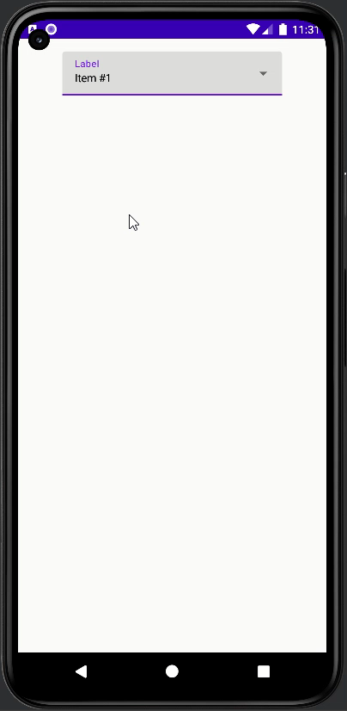

Slide 8
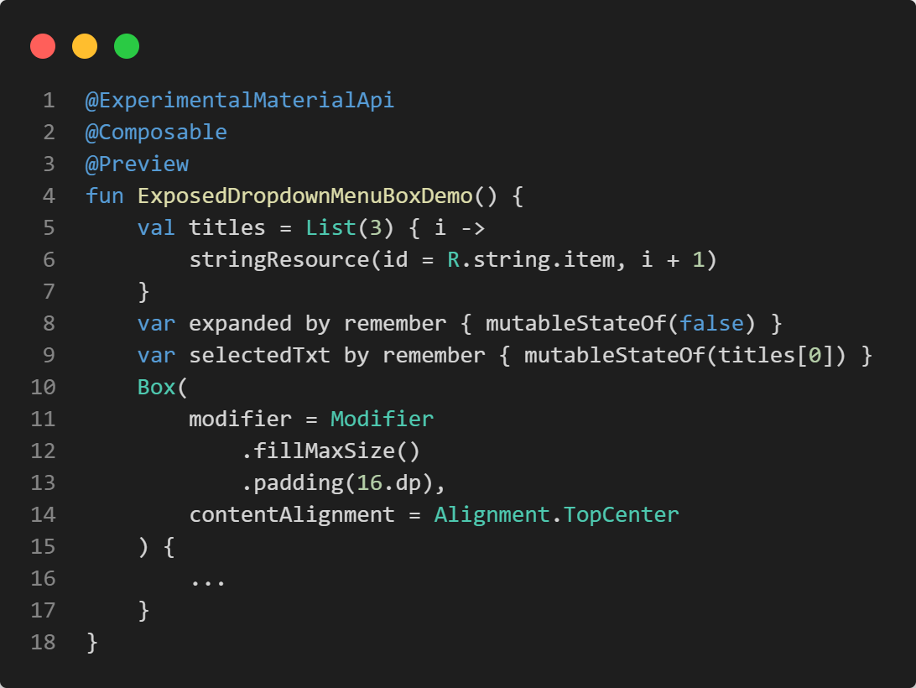

Slide 9
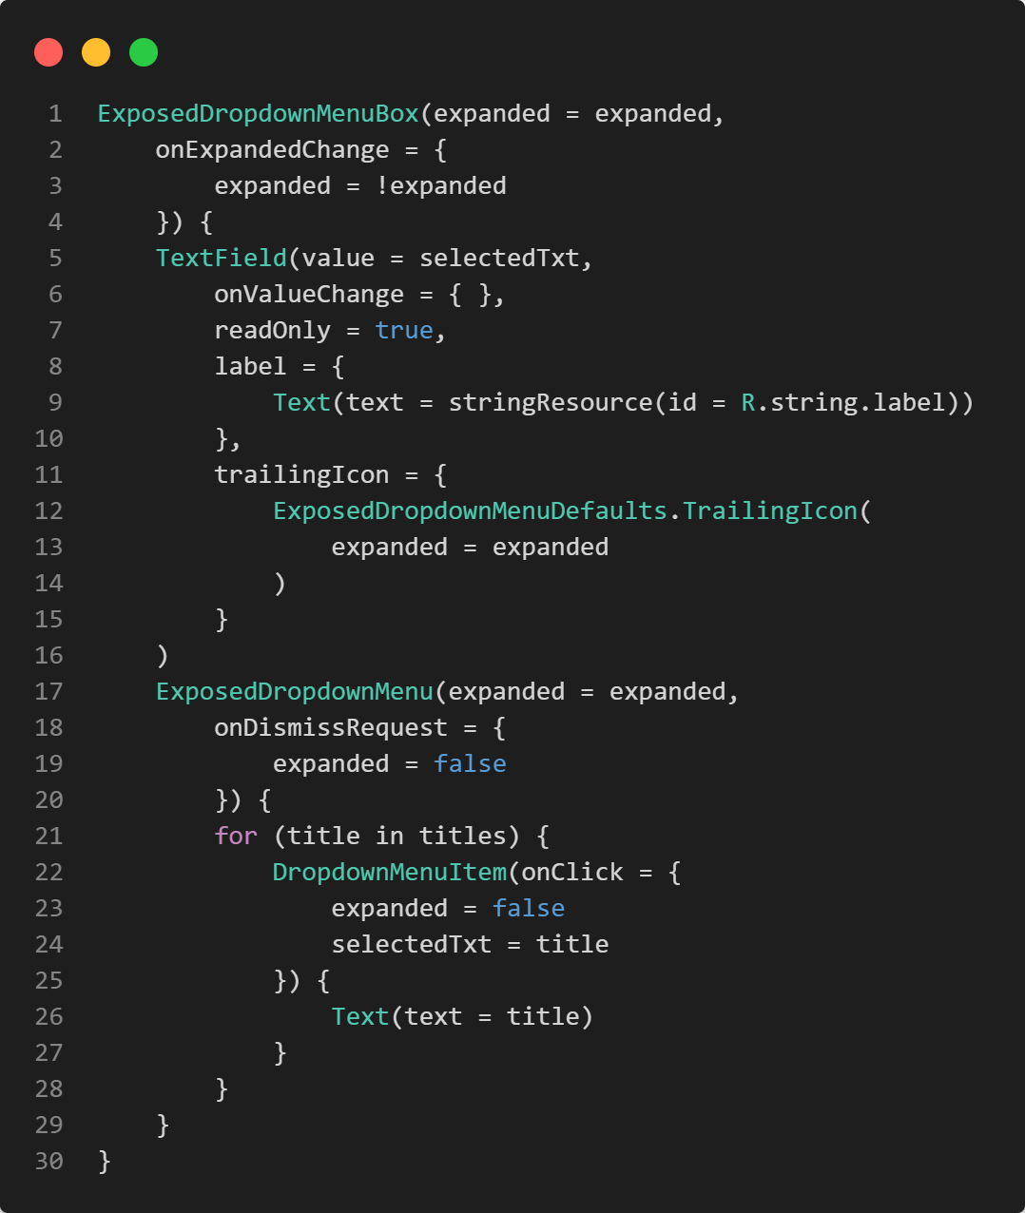

Slide 10
Row()
x axis
y axis
Column()
Box()
z axis

Slide 11
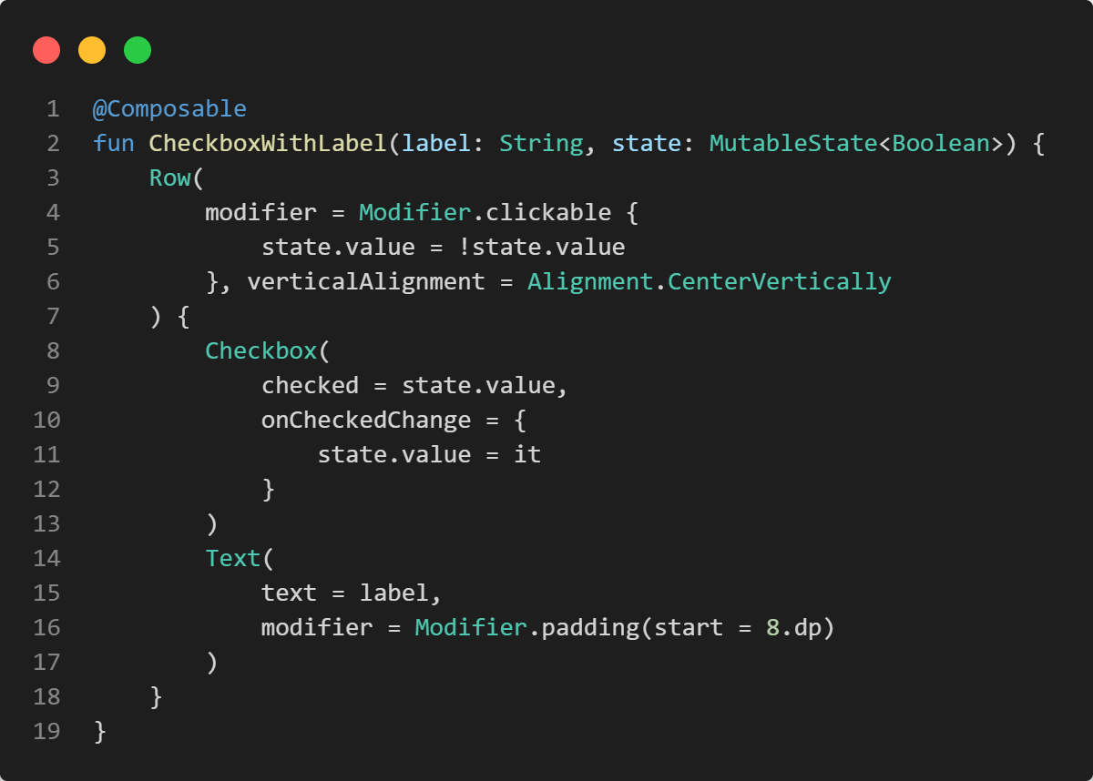
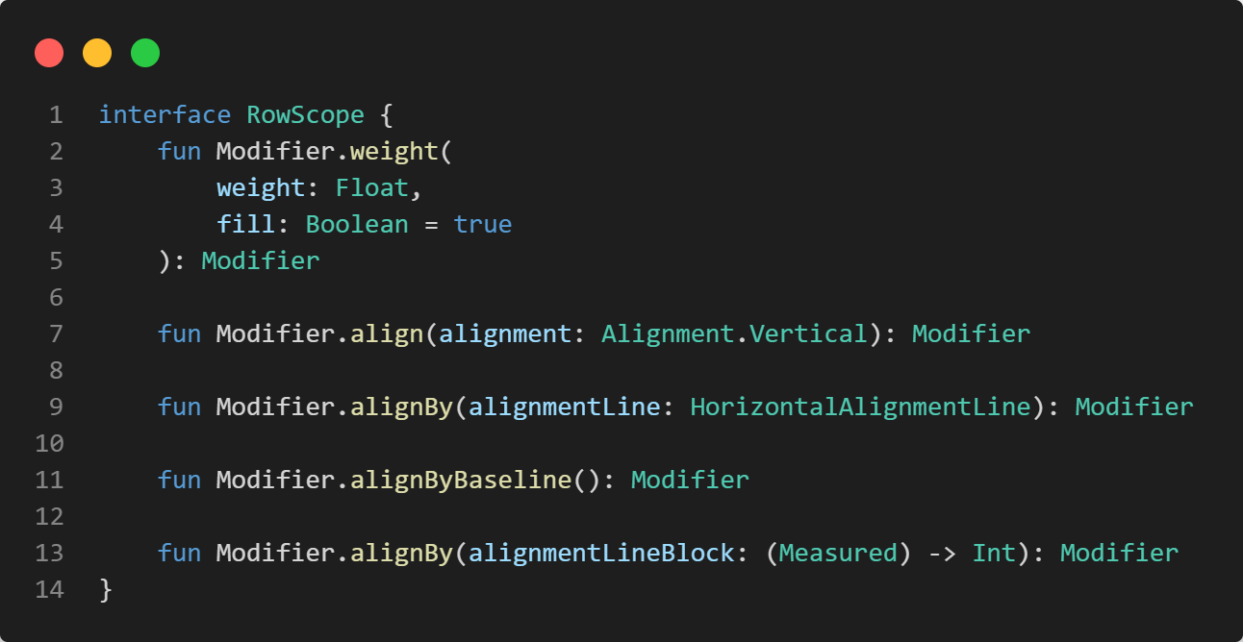
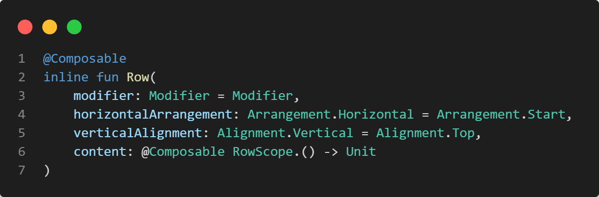

Slide 12
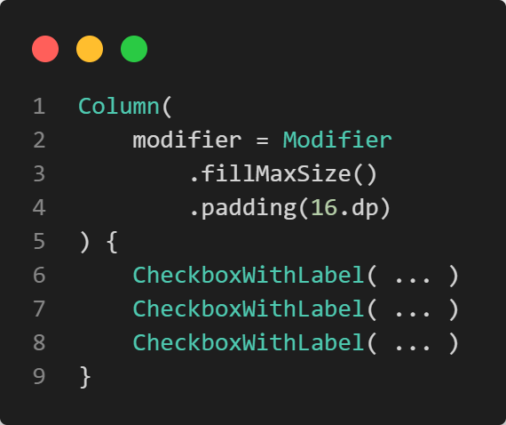
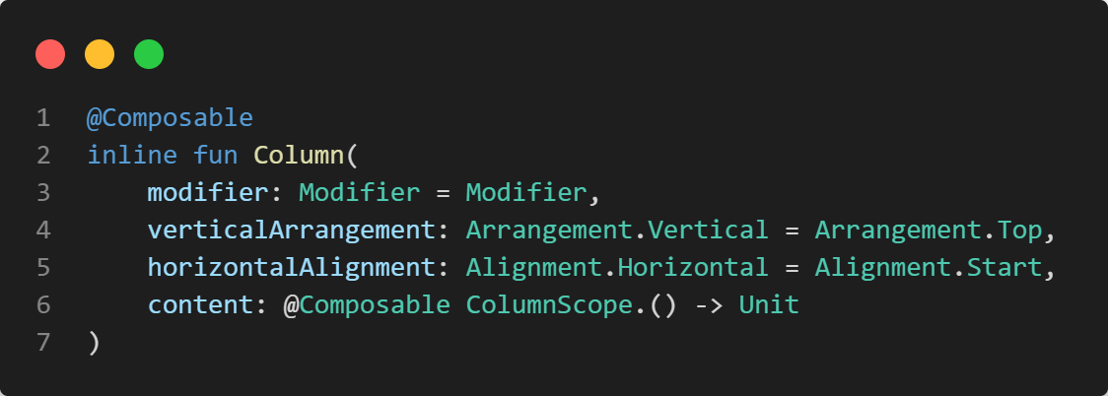
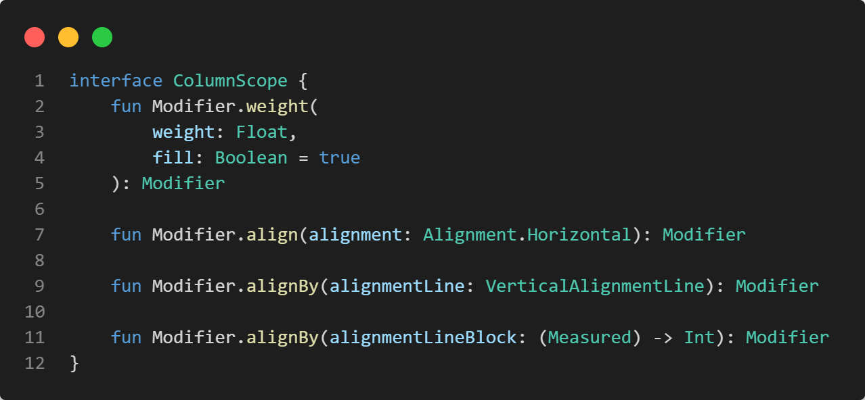

Slide 13
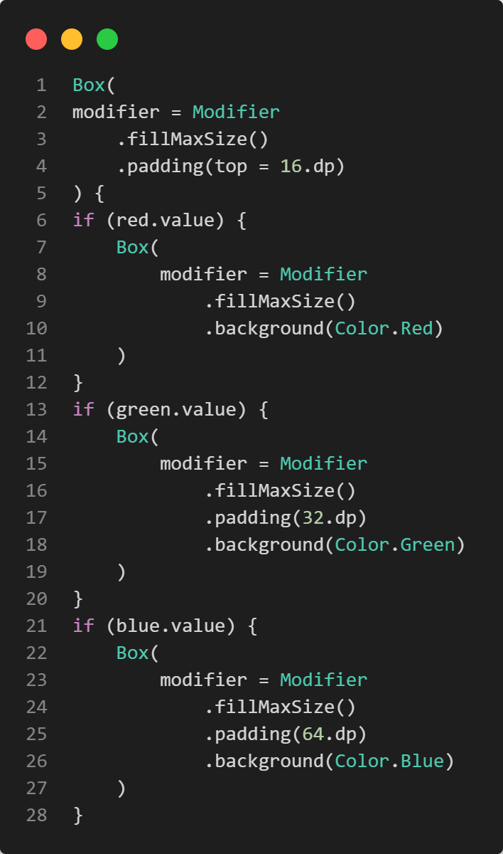
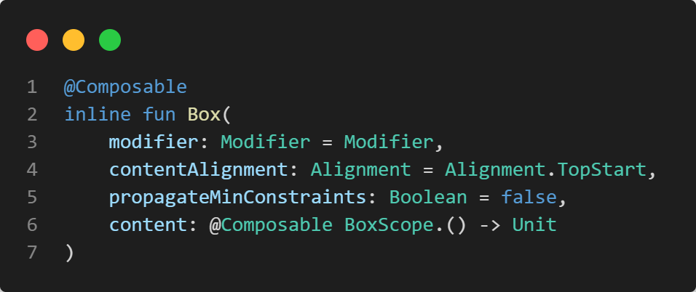
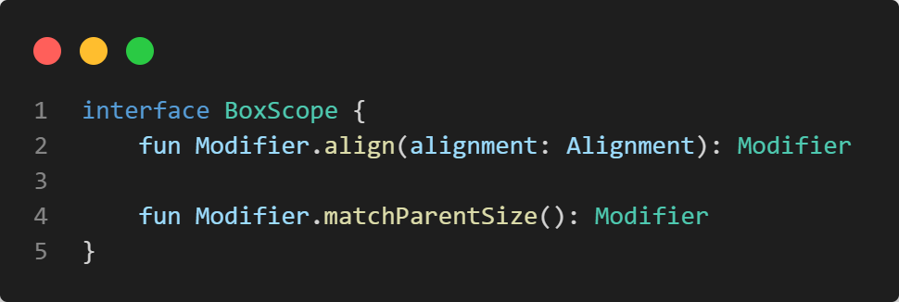

Slide 14
Isn‘t nesting layouts costly?🤔
Didn‘t Google introduce ConstraintLayout to better handle complex UIs?
With Jetpack Compose children are measured only once
So, layout hierarchies are no problem
But there’s ConstraintLayout(), too (after the break)

Slide 15
Non-visual composables
remember, mutableStateOf, ...
stringResource, dimensionResource, painterResource, ...
LaunchedEffect, DisposableEffect, ...

Slide 16

Exercise
https://unsplash.com/photos/IZOAOjvwhaM

Slide 17
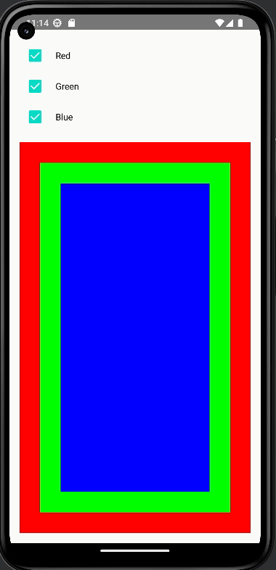
PredefinedLayoutDemo
Write an app with checkboxes that show and hide colored boxes
Use Row()to combine Checkbox() and Text()
Column() arranges the three labeled checkboxes and one Box() containing the colored boxes

Slide 18
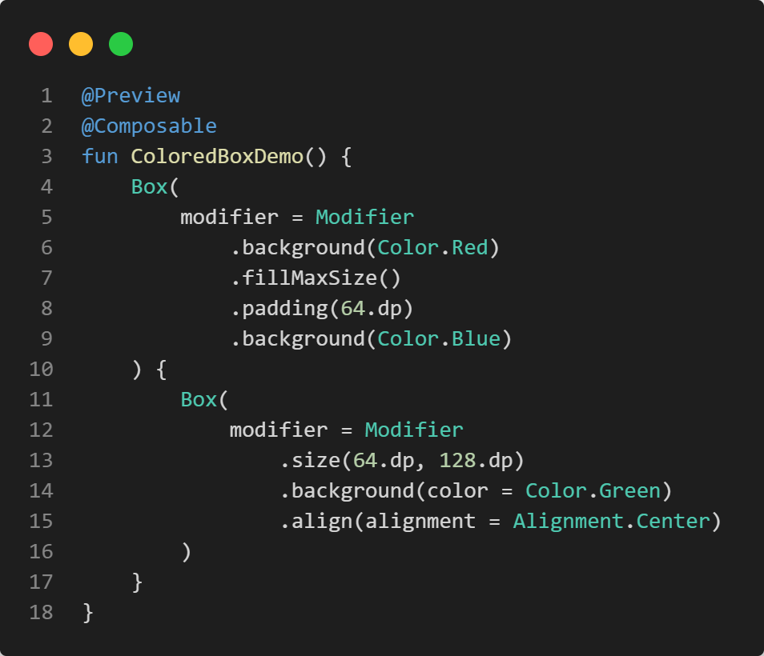
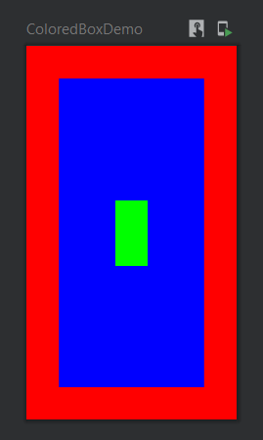

Slide 19
Modifier amend composables with visual properties and behavior
They form chains, which start with Modifier
The order in the code defines when a modifier is applied

Slide 20
.fillMaxSize() maximizes a composable
.width() and .size() declare the preferred width or size
.padding() creates an inward-facing space
.background(color = ...) creates a colored background

Slide 21

Further reading
Chapter 4: Laying Out UI Elements
free PDF

Slide 22

Questions…?
Lunch break… 😍

